Slide 1

CMR COLLEGE OF ENGINEERING & TECHNOLOGY
Kandlakoya, Medchal, Hyderabad - 501401
Department of Computer Science and Engineering
Tax Evasion Detection: A fusion of AdaBoost Classifiers and Deep Learning Models.
Name of the student:
Manoj Kumar
(20H51A0598)
M.Pooja
(20H51A05C9)
M.Srivardhan
(20H51A05D0)
Batch No.: 26
Under esteemed guidance of
MS.M.N.Sailaja
(Assistant professor)
Batch: 2020-2024 Major Project Phase 1

Slide 2
Outline
Abstract
Introduction
Research Objective
Problem Definition
Scope of the Project
Literature Review
Implementation of Existing system
Conclusion
References
Notes:
2

Slide 3
Abstract
Notes:
3

Slide 4
ABSTRACT
Income Tax plays an important role in the developmental activities of a nation. However some companies try to avoid or minimize their tax by showing reduced profits.
Detecting tax fraud is a top objective for practically all tax agencies in order to maximize revenues and maintain a high level of compliance.
The identification of tax evasion plays an important role in ensuring tax order, promoting the level of tax collection and management, and reducing tax losses.
Companies can be identified by studying and analyzing the balance sheet indicators like: Sale Volume Vs Purchase Volume, Employee Growth Vs Taxpaid, Net Income Vs Tax Increase, Gross Loss Vs Tax, Gross Revenue Vs Tax Paid, and Fixed Assets Vs Tax Paid.
The proposed system helps IT department for identifying the companies that are most likely to evade the tax by analyzing the data using AdaBoost analysis and Neural net analysis.

Slide 5
INTRODUCTION
Notes:
5

Slide 6
Introduction
Earnings tax is an important source of revenue to government in both growing and evolved nations. The amount of revenue to be generated by government from such taxes for its expenditure programmers relies upon, among different things, at the willingness of the taxpayers to conform with the tax legal guidelines of a rustic.
This is a tax imposed by the government on many types of earnings made by individuals and businesses, and it varies depending on the amount gained through wages, salaries, and the business’s individual circumstances.
There are a number of reasons why people evade taxes. Some people do it because they believe they are not being treated fairly by the government. Others do it because they think they can get away with it. And still others do it because they do not understand the tax laws.
Tax evasion is a crime that has a number of negative consequences. It deprives governments of revenue that they need to fund essential services. It also creates an unfair playing field for businesses and individuals who do pay their taxes. And it can lead to a loss of trust in government.
Notes:
6

Slide 7
Research Objective
Notes:
7

Slide 8
Research objective
To identify appropriate algorithms, techniques and tools for analyzing data on tax evasion.
To develop strategies to reduce tax evasion.
To develop a prediction model for detection of tax evasion.
To evaluate tax evasion detection models that can examine tax evasion practices.
To assess the impact of tax evasion on government revenue and economic growth.

Slide 9
Problem Definition
Notes:
9

Slide 10
Problem Definition
The objective of this project is to develop and implement an advanced tax evasion detection system that leverages data analytics, machine learning, and artificial intelligence techniques to identify potential cases of tax evasion with greater accuracy and efficiency.
Tax evasion remains a persistent challenge with significant implications for government revenues, social equity, and the overall integrity of the tax system.
There is a pressing need to develop a comprehensive and technologically advanced tax evasion detection system that leverages cutting-edge data analytics, machine learning , and artificial intelligence techniques.

Slide 11
Scope of the Project
Notes:
11

Slide 12
Scope of the Project
This work considers tax evasion cases based on Cor-porate Income Tax (CIT) and Value-Added Tax (VAT)using the tax system as a case study.
The dataset is created by gathering knowledge from a literature review and the SET website.
Suspicious cases are based on the risk assessment cri-teria selected from the literature review.

Slide 13
Literature Review
Notes:
13

Slide 14
Comparison table for the existing system
S.No | Authors and Journal Name& Year of publication | Problem Statement | Name of the Proposed solution/Method | Solution | Remarks
1 | Assylbekov, Z., Melnykov, I., Bekishev, R., Baltabayeva, A., Bissengaliyeva, D., & Mamlin,E .3 June 2022 | One of the main contributions of this study is the use of open data in the problem of identifying tax evasion. Most works in this field need sensitive data. Another contribution is the use of graph neural networks, GNNs (Zhang, Song, Huang, Swami, & Chawla, 2019), in the tax evasion problem | Tax evasion identification using open data and artificial intelligence | The proposed approach is to model the identification of tax evaders as a binary classification between the potential "default" and "reputable" profiles. The dataset construction activities and data analysis followed the process model for data mining called CRISP-DM (Wirth & Hipp, 2000). | Tax evasion affects the horizontal and vertical equity of a tax system, as well as the efficiency of the free market in general and of its tax system in particular. It certainly affects the revenue productivity of the tax system. Unchecked or deficiently controlled tax evasion builds cynicism about the role of the public sector.
2 | S. Chen, X. Chen, Q. Cheng, and T. Shevlin, "Are family firms more tax aggressive than non-family firms?," J.Financ. Econ.International Journal of Recent Technology and Engineering Volume-8, Issue-2511, September 2019 | Corporate tax is a vital source of government revenues especially for developing countries. It is a compulsory levy by the government on companies’ earnings to assist government’s social and political objectives. Indeed, in Malaysia corporate tax is one of the major contributors to the government revenue. | Tax Avoidance Detection Based on Machine Learning of Malaysian Government-Linked Companies | The dataset is a collection of tax avoidance firms and non-tax avoidance firms among GLCs for the period 2010 to2016. This study uses Effective Tax Rates (ETR) to measure tax avoidance, which measured as the ratio of the total tax expenses to the total income before tax. | Tax evasion varies by sector (agriculture, industry, commerce), organization of production (small trader or business, companies), or type of economic agent (salaried, self-employed, capital owner). It is also affected by social ethics and the standards set by those that govern. Given those standards, it is further affected by the attitude toward risk of a potential taxpayer
3 | H. Dettmar, X. Liu, R. Johnson, and A. Payne, ‘‘Knowledge-based data generation,’’ Knowl.-Based Syst., vol. 11, nos. 3–4, pp. 167–177, Nov. 1998,published:16 may 2023 | The objective of this project is to develop and implement an advanced tax evasion detection system that leverages data analytics, machine learning, and artificial intelligence techniques to identify potential cases of tax evasion with greater accuracy and efficiency. | Enhanced tax evasion detection using Ada boost classifier | This project entitled "Tax Evasion Detection using Adaboost Classifier." is useful to the income Tax department to identify the companies that are likely to evade the tax.This project is indirect useful to enhance the national revenue by forcing the tax evaders to pay the tax. | Tax evasion affects the horizontal and vertical equity of a tax system, as well as the efficiency of the free market in general and of its tax system in particular. It certainly affects the revenue productivity of the tax system. Unchecked or deficiently controlled tax evasion builds cynicism about the role of the public sector. It tends to complicate the tax structure as the latter begins to anticipate tax evasion. The use of effective and quickly applied penalties to counter tax evasion has an impact on its extent and spread.However, their application does not necessarily imply even a second-best solution for the correction of inequities if many tax evaders do not get caught and remain unaffected by penalties.'

Slide 15
Comparison table for the existing system
s.no | Authors and Journal Name & Year of publication | Problem Statement | Name of the Proposed solution/Method by authors | solution | Remarks
4 | Smelser, N.J.; Baltes, P.B. International Encyclopedia of the Social & Behavioral Sciences, 11th ed.; Elsevier: Amsterdam, The Netherlands, 2011.31 may 2022 | Detecting tax fraud is a top objective for practically all tax agencies in order to maximize revenues and maintain a high level of compliance. Data mining, machine learning, and other approaches such as traditional random auditing have been used in many studies to deal with tax fraud. | Fraud Detection Using Neural Networks: A Case Study of Income Tax | Recently, researchers have taken a renewed interest in Artificial Neural Networks (ANN) owing to their functional structure and being at the core of deep learning. Just as birds inspired the construction of the airplane, the human brain motivated the development of ANN with the objective of imitating the functioning structure of the human brain in order to enable a computer to learn in the same way that people do. Thus, ANN was created as a replication of the generalized mathematical model of the human central nervous systems | It was found that there is no difference in income tax fraud between businesses that import and export goods (customs) and domestic businesses, except that customs businesses are more related to tax fraud than domestic businesses. The time of the business that shows the difference in time from when a business was registered to the time of audit was also revealed to be a feature that is related to tax fraud.
5 | Lee and Y. J. Shin, "Machine learning for enterprises: ap-plications, algorithm selection, and challenges," Business Horizons, vol. 63, no. 2,5 September 2022 | As one of the most important sources of government revenue, tax currently plays a vital role in the economy of any country [3). By using various tax policies, governments can use tax tools and adjust their varioussuch as socal justice, proper distributon of ficome anelimination of the class gap between different classes of society, stabilization of prices, reduction of unemployment, economic prosperity, and increase of investment | Towards Tax Evasion Detection Using Improved Particle Swarm Optimization Algorithm | This section evaluates three proposed methods (IPSO-MLP, IPSO-SVM, and LR) based on machine learning for tax evasion detection. As mentioned earlier, this paper uses the dataset of the General Administration of Tax Affairs of West Azerbaijan Province in 2019 with different groups of 1500 samples and nine features (gross taxable income, including expressive tax net income, related tax, tax exemptions, tax discount, tax payable, payments made, taxable balance, and class feature).The models are implemented in MATLAB 2017b. | Tax evasion varies by sector (agriculture, industry, commerce), organization of production (small trader or business, companies), or type of economic agent (salaried, self-employed, capital owner). It is also affected by social ethics and the standards set by those that govern. Given those standards, it is further affected by the attitude toward risk of a potential taxpayer.

Slide 16
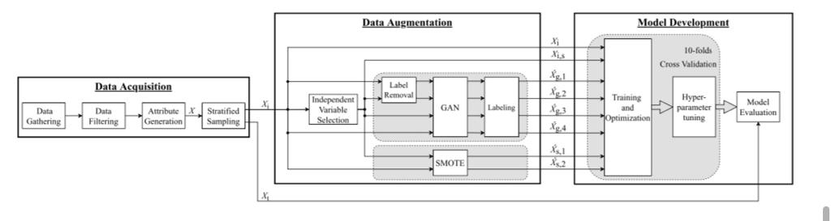
Implementation of Existing System
1. DATA ACQUISITION
Data acquisition is the first step in obtaining the dataset. Four steps are involved in this process: Data Gathering, Data Filtering, Attribute Generation, and Stratified Sampling.

Slide 17
2. DATA AUGMENTATION
This section discusses the proposed process. These processes include generating datasets, augmenting them for additional instances, and selecting an appropriate model. In the next section, results are presented and discussed.
3. MODEL DEVELOPMENT
After the ‘‘Data Acquisition’’ and ‘‘Data Augmentation’’ steps are completed, the collected and synthetic datasets are used as inputs in the third process ‘‘Model Development.’’ The training sets for this step are Xi, Xi,s, Xˆg,1, Xˆg,2, Xˆg,3, Xˆg,4, Xˆs,1, and Xˆs,2. The testing set is Xt. In this step, the software ‘‘RapidMiner Studio’’ software is used to tune hyperparameters and construct machine learning models.

Slide 18
Result
After data preparation, Artificial Neural Networks with optimal parameters were applied. The training process was evaluated using training and evaluation loss, as well as the accuracy. Before dealing with imbalance, the model gives an accuracy of 90% but a very low precision of 68% which calls for questions about the model’s ability to classify. The Area Under Receiver Characteristic Curve (AUC-ROC) for the original data was 94%.
After dealing with the imbalance, accuracy was 92% and precision goes to 85%. The AUC-ROC after dealing with the data imbalance was 95%.
From the learning curves in Figure, it can be seen that the training loss kept on dropping throughout the process, which is the same for the validation loss.

Slide 19
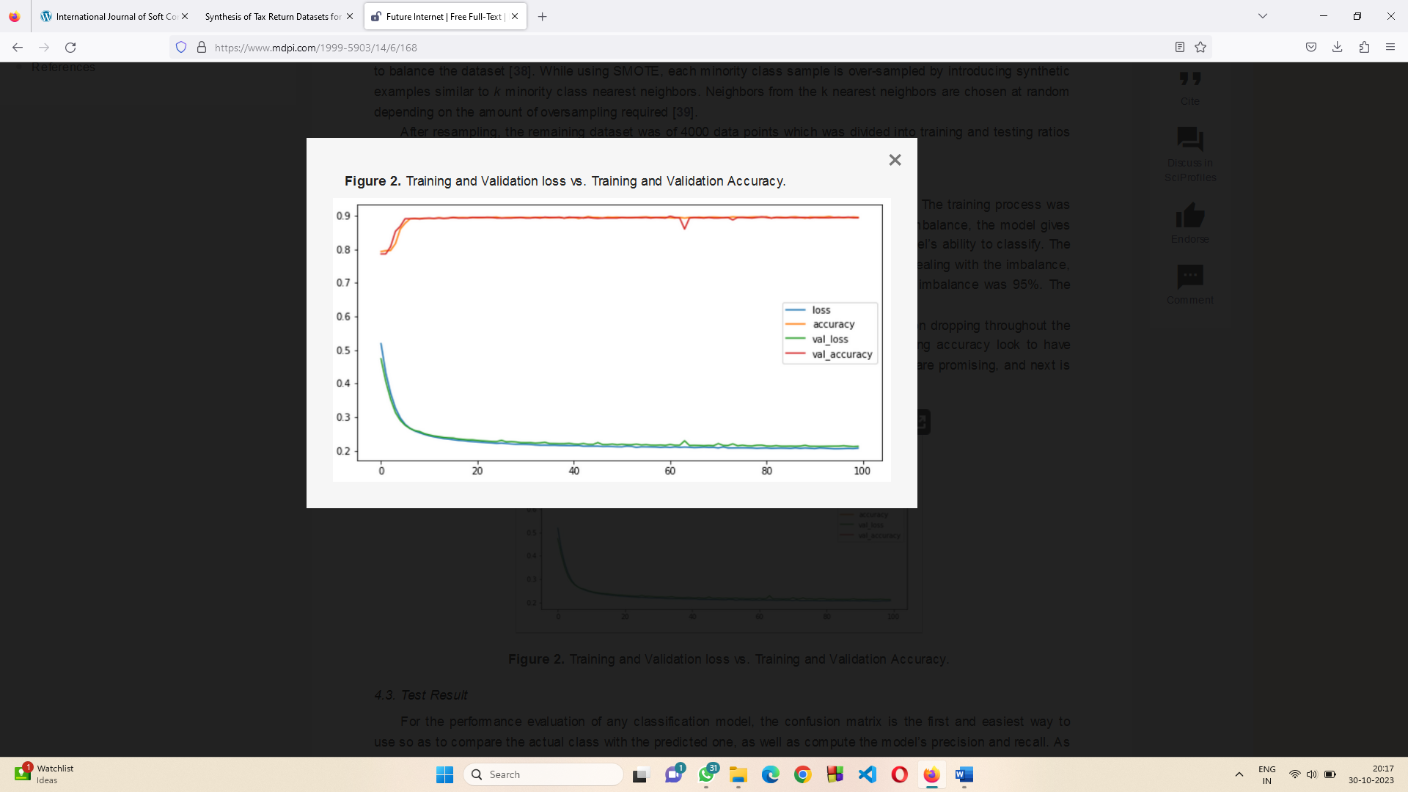
On the contrary, the training and testing accuracy look to have reached the maximum level midway through training. From the learning curves, the results are promising, and next is testing the model to verify if it does not over-fit.
Training and validation loss Vs Training and validation accuracy

Slide 20
Conclusion
This project entitled "Tax Evasion Detection using Adaboost Classifier." is useful to the income Tax department to identify the companies that are likely to evade the tax.
This project is indirect useful to enhance the national revenue by forcing the tax evaders to pay the tax.
By developing an advanced tax evasion detection system, this project aims to improve tax compliance, increase government revenues, and promote fairness in the tax system.
It will empower tax authorities with the tools and insights needed to identify and address tax evasion effectively and efficiently.
we have laid the groundwork for a comprehensive solution that integrates diverse data sources, engineers relevant features, and employs advanced machine learning models to predict potential tax evasion cases.

Slide 21
References
Tax Justice Network. The State of Tax Justice 2021. Accessed: Nov. 10, 2022. [Online]. Available: https://taxjustice.net/reports/the-state of-tax-justice-2021/ [14] I. Kose, M. Gokturk, and K. Kilic, ‘‘An interactive machine-learning based electronic fraud and abuse detection system in healthcare insur ance,’’ Appl. Soft Comput., vol. 36, pp. 283–299, Nov. 2015, doi: 10.1016/j.asoc.2015.07.018.
R. Benkraiem, A. Uyar, M. Kilic, and F. Schneider, "Ethical behavior, auditing strength, and tax evasion: A worldwide perspective," J. Int.Accounting, Auditing Taxation, vol. 43, Art. no. 100380, doi:10.1016/j. intaccaudtax.2021.100380.
A. Uyar, K. Nimer, C. Kuzey, M. Shahbaz, and F. Schneider, "Can e-government initiatives alleviate tax evasion? The moderation effect of ICT," Technol. Forecasting Social Change, vol. 166, Art. no. 120597,doi: 10.1016/ j. techfore.2021.120597

Slide 22
Thank You!

